Slide 1

AI and the Environment: An Introduction to machine learning for environmental scientists

Slide 2
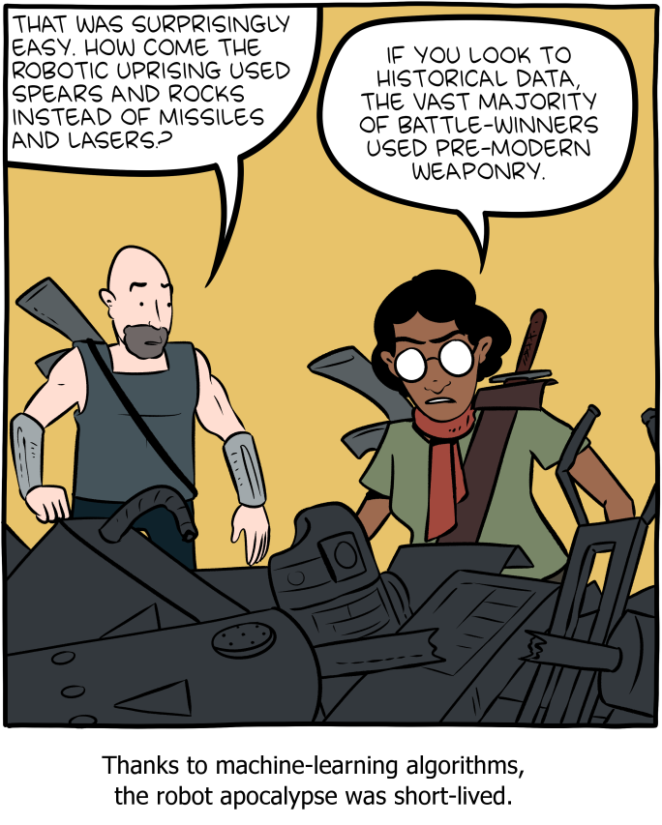
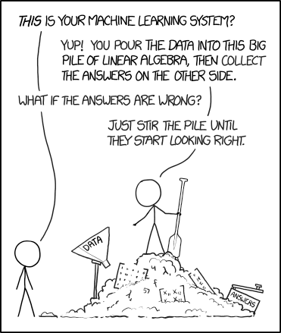
Machine Learning
¹XKCD, ²SMBC

Slide 3
The Course
Day 1:
Lecture 1 : What is Machine Learning and how can we use it.
Lecture 2: Linear and Logistic Regression
Practical 1: Linear Regression
Lecture 3: Decision Trees
Practical 3: Decision Trees
Day 2:
Lecture 4: Deep Learning and Neural Networks
Lecture 5: The Methods of Neural Networks
Practical 4: Build a Neural Network from Scratch

Slide 4
What is AI?
Artificial Intelligence (AI) is generally a useless term that describes anything that attempts to replicate a level of intelligence only seen in humans.
It’s generally used as a buzz word that doesn’t mean very much to attract attention. It worked for this course….
Machine learning is something that is used to replicate human intelligence. Or even perform above it.

Slide 5
What is Machine Learning?
Machine Learning (ML) is the current approach to performing tasks that replicate human intelligence.
ML is almost entirely algorithms based on maths.
They use a variety of mathematical methods to make predictions.
The learning aspect of it comes from their ability to adjust their predictions based on the data.
They “learn” to make better predictions by adjusting their internal maths.

Slide 6
What is Deep Learning?
Deep Learning (DL) is a particular form of ML that utilises huge data sets to learn more to higher accuracy and more effectively than regular methods and even humans.
The primary DL method are Neural Networks (NN) which are based on the principle of emulating a human brain in a way.
These are the cutting edge ML methods and are already capable of incredible achievements

Slide 7
AI vs ML vs DL
AI
ML
DL

Slide 8
Supervision
Machine learning in general falls into two major categories:
1. Supervised: ML which is trained using a classified dataset where it given the correct answers and adjusts the prediction based on that.
2. Unsupervised: ML which has no correct answers to compare to and simply looks for patterns in the data.

Slide 9
What can we use ML for?
These are used for 2 major purposes.
1. Data “trawling”: looking through large data sets to find things that cluster together.
2. Prediction or Classification: This is when you train an algorithm to classify data into groups or make predictions based on that data.

Slide 10


Current Uses of ML?
Machine learning is all around you in day to day life.

Slide 11
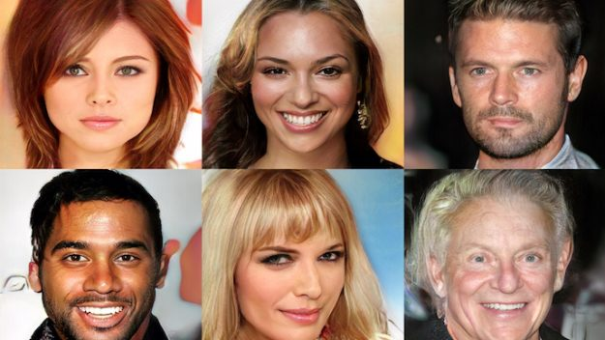
Current Uses of ML?
Which face is fake?

Slide 12
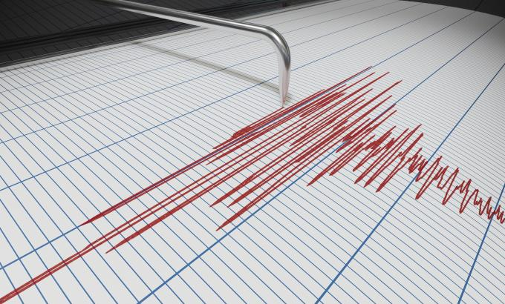
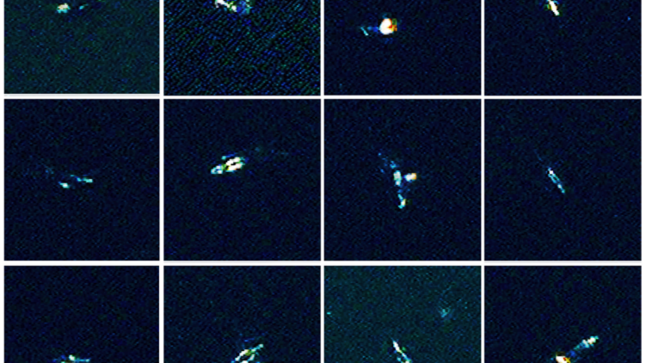
AI and the Environment
Machine learning is already making an impact in environmental sciences.

Slide 13
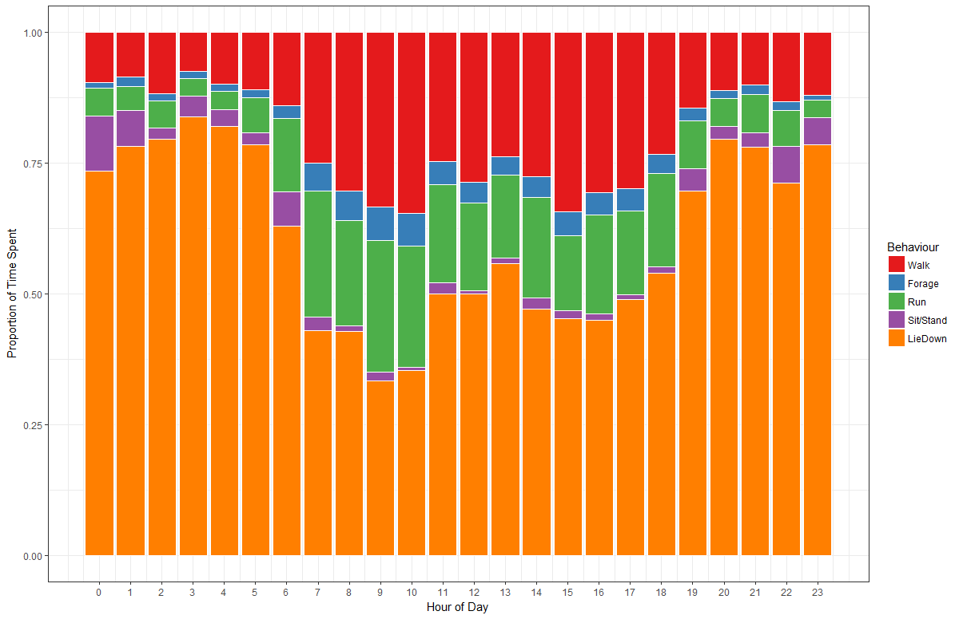
AI and the Environment
Machine learning is already making an impact in environmental sciences.

Slide 14

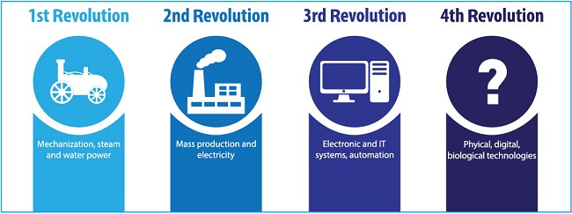
Where is it going?
Machine learning is already making an impact in environmental sciences.

Slide 15
Ok… So how does it work?
Well… The real answer is that it depends on the method you are using.
They each have their own form of underlying maths that makes them but the methods of learning tend to be similar.
Weights and Biases

Slide 16
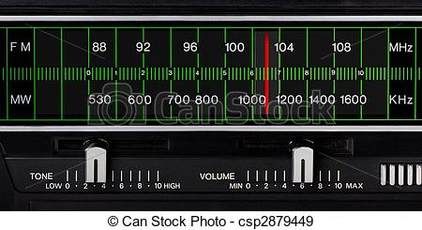
Ok… So how does it work?
But for simplicities sake lets initially think of them as dials and switches tuning the radio.
Dials and Switches

Slide 17
Ok… So how does it work?
But for simplicities sake lets initially think of them as dials and switches tuning the radio.
If I have a radio and want to find a station that is playing classic rock but start at a random frequency I need to tune the dials until I find the correct station.
Every time I change the dials I am listening to a new frequency.
I then need to change the dials in response to that new frequency.
The more wrong the frequency the more I need to change the dial.

Slide 18
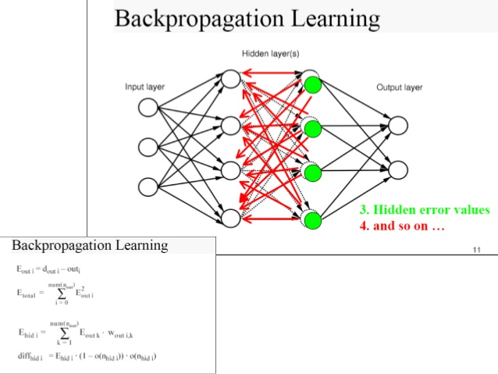
Backpropagation
How much should we adjust the frequency?
This is where the hardest maths in machine learning comes in.

Slide 19
Error
The first concept is error.
Error is a measure of how wrong the prediction of your machine learning algorithm was.
This needs to be calculated in a mathematical way.
This calculation is done with the error function of which there are many options to choose

Slide 20
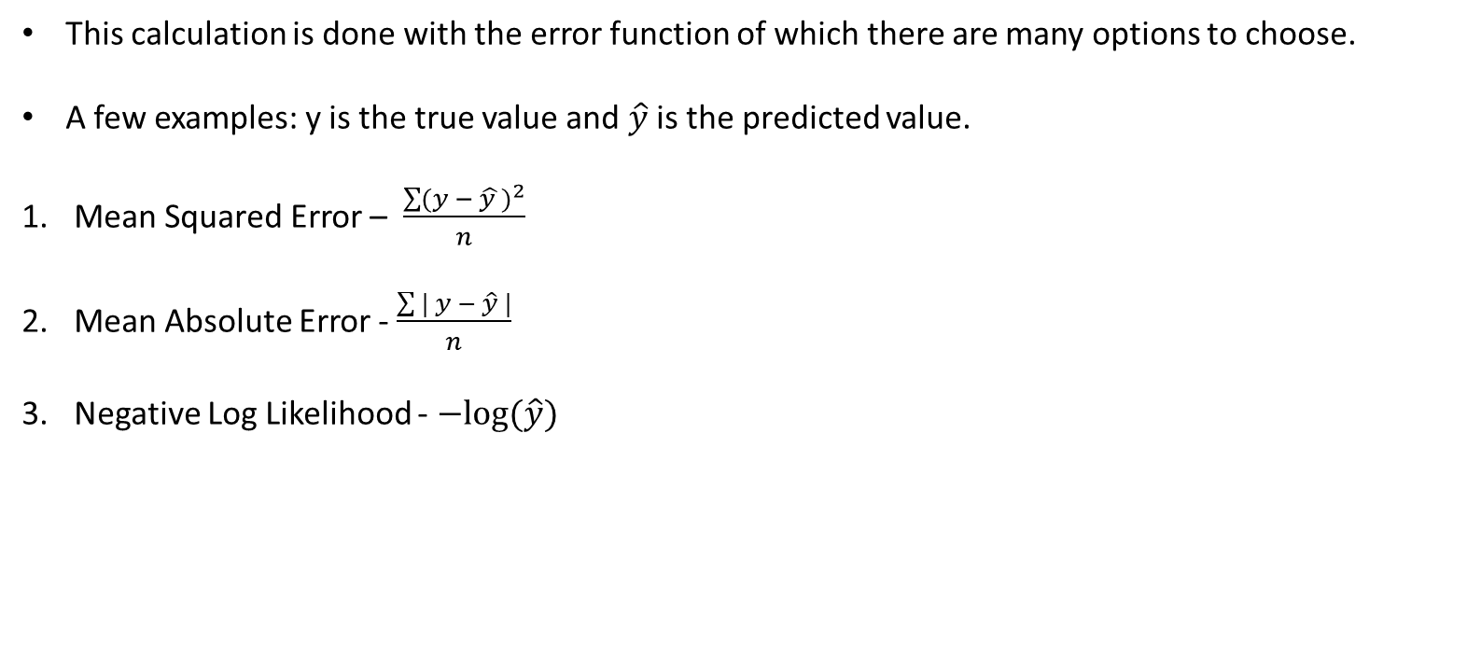
Error
This calculation is done with the error function of which there are many options to choose.
A few examples: y is the true value and $\hat{y}$ is the predicted value.
Mean Squared Error – $\frac{\sum{{(y − \hat{y })}^{2}}}{n}$
Mean Absolute Error - $\frac{\sum{| y − \hat{y} |}}{n}$
Negative Log Likelihood - $−log⁡(\hat{y})$

Slide 21
Backpropagation
Ok now we have a direct measure of how badly we did how do we then adjust all our switches and dials for how wrong we were?
This is where backpropagation comes in.
Backpropagation is where your send the error back through to correct your dials and switches.

Slide 22
Backpropagation
This is where we use complex maths to get a measure of how much each weight / bias has to change based on it’s own value and the error.
How do you work out the change from one thing to another?

Slide 23
Backpropagation
This is where we use complex maths to get a measure of how much each weight / bias has to change based on it’s own value and the error.
How do you work out the change from one thing to another?
Differentiation!

Slide 24
Backpropagation
Differentiation!
Calculating the differential of the error in respect to the weights and biases gives you how much you need to adjust the weights.
But we won’t go too deep into the details of it right now.

Slide 25
A Summary
So to explain how it learns step by step.

Slide 26
A Summary
So to explain how it learns step by step.
First you have your data input.
Data Input

Slide 27
A Summary
So to explain how it learns step by step.
You then put that data into your ML Algorithm of Choice.
Data Input
ML Magic

Slide 28
A Summary
So to explain how it learns step by step.
Your ML algorithm then gives you an output prediction
Data Input
ML Magic
Prediction

Slide 29
A Summary
True Value
So to explain how it learns step by step.
Compare it to the true value.
Data Input
ML Magic
Prediction

Slide 30
A Summary
True Value
So to explain how it learns step by step.
Calculate the error.
Calculate Error
Data Input
ML Magic
Prediction

Slide 31
A Summary
True Value
So to explain how it learns step by step.
Back Propagate the error into and through the algorithm
Calculate Error
Data Input
ML Magic
Prediction

Slide 32
A Summary
True Value
So to explain how it learns step by step.
Rinse and repeat
Calculate Error
Data Input
ML Magic
Prediction

Slide 33
Lets talk about Data
So we’ve covered the basis of how ML algorithms actually learn but there are of course important things to think about before we can even start putting the data into an algorithm.
What are the critical things we want to think about in terms of our data?
What data do we even need to feed into our algorithm?

Slide 34
Features
In ML the input we put into the algorithm is often called features
Features are extracted from the data and have often undergone some form of transformation or dimensionality reduction.
This process is called feature engineering and is an important part of ML.

Slide 35
Features
Choosing the correct features is an important part of any ML project, sometimes this means using only some of your data, or creating new features.
Lets think about what data you would want to go into various models:
A model that wants to predict chance of a fire in a forest. What data would you want?

Slide 36
Features
Choosing the correct features is an important part of any ML project, sometimes this means using only some of your data, or creating new features.
Lets think about what data you would want to go into various models:
A model that wants to predict chance of a fire in a forest. What data would you want?
What format would all those data be in?

Slide 37
Feature Engineering
As with most statistics machine learning algorithms often don’t like funky data
Particularly things like neural networks like normal data.
This often will mean transforming data, normalising data and often PCAs to collapse the dimensions.
You may often make new features as well that are summaries of other ones.
The important thing is information.

Slide 38
Features and information
The ability of any algorithm to have predictive power is based on the information that the input features have.
You will often be surprised how the addition of one particular feature causes a sudden jump up in predictive power.
This is because that feature contains a high level of information. You might not know why but the computer sees something in it.
This is based on information theory and we won’t cover that too much.

Slide 39

Complexity vs Explainability
So what does a computer see when it is making a prediction?
What do you see here?
Why?

Slide 40
Complexity vs Explainability
There is no reason to assume that the reason you classify this as a cat is the same a ML algorithm classifies it as a cat.
Maybe it’s main feature is nose to ear ratio? Who knows?

Slide 41
Complexity vs Explainability
This brings in the question of how explainable do we want our ML to be?
It is important to consider this kind of thing when building a model.
What is the purpose of the model?
Do you want just a prediction or do you want to know what elements are causing that prediction?
The more complex the algorithm generally the less explanatory power you have.

Slide 42
Different ML algorithms
So we’ve covered how learning happens, what to do with our data to make it happen and some of the shortfalls but what are the tools actually available to us?
Well we have spectrums of simple to complex, explainable to black box, tolerant to sensitive.
Choosing the appropriate algorithm is about your data.
But here are some of the most common ones:

Slide 43
Different ML algorithms
Linear Regression
Naïve Bayes
Support Vector Machine
Decision Tree
Neural Networks:
ANN
CNN
RNN
GAN

Slide 44
Different ML algorithms
Linear Regression
Naïve Bayes
Support Vector Machine
Decision Tree
Neural Networks:
ANN
CNN
RNN
GAN

Slide 45
Linear Regression – Up Next
Yep Linear Regression is a form of ML, turns out you’ve been doing it for years…

